Slide 1
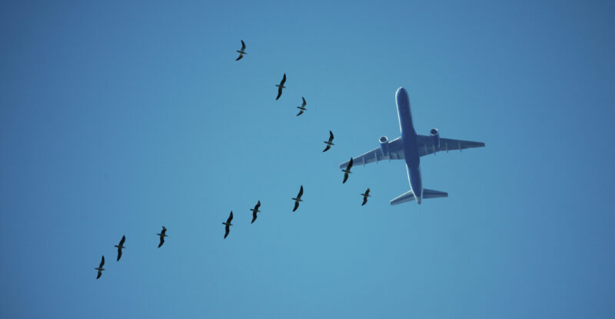
Data Visualization of Bird Strikes between 2000 – 2011

Slide 2
Introduction
A bird strike is a collision between a bird and an aircraft, occurring during flight, take-off, or landing. This can also involve other wildlife like bats or ground animals. Bird strikes are common and pose significant risks to aircraft safety, potentially causing structural damage or engine failure. They are most frequent during take-off, climb, approach, and landing.
This presentation visualizes FAA data on bird strikes from 2000-2011.

Slide 3
Problem Statement
The goal of this project is to analyze the bird strike incidents happened between 2000-2011. To achieve the goal, we used a data set that is collected by FAA during 2000-2011. The objective of the project is to perform data visualization techniques to understand insights of the data. This project aims apply various Business Intelligence tools such as Tableau or Power BI to get a visual understanding of the data.

Slide 4
Main KPIs
Total Bird Strikes Cases
Total Cost in Repairing
Total Number of People Injured
Average Altitude of the airplanes in different phases at the time of strike

Slide 5
Insights
● Visuals Depicting the Number of Bird Strikes
● Yearly Analysis & Bird Strikes in the US
● Top 10 US Airlines in terms of having encountered bird strikes
● Airports with most incidents of bird strikes – Top 50
● Yearly Cost Incurred due to Bird Strikes:
● When do most bird strikes occur?
● Altitude of airplanes at the time of strike
● Phase of flight at the time of the strike.
● Average Altitude of the airplanes in different phases at the time of strike
● Effect of Bird Strikes & Impact on Flight
● Effect of Strike at Different Altitude
● Were Pilots Informed? & Prior Warning and Effect of Strike Relation

Slide 6
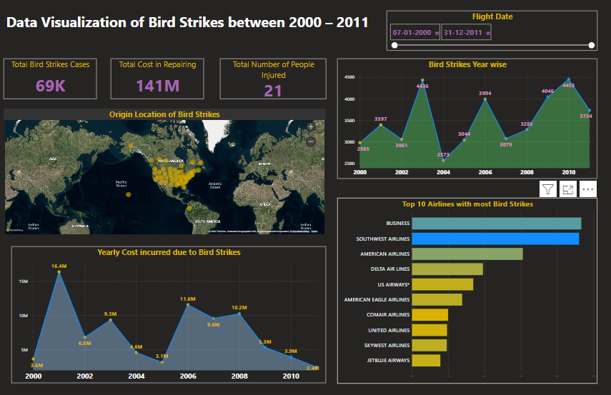
My Design
Page 1

Slide 7
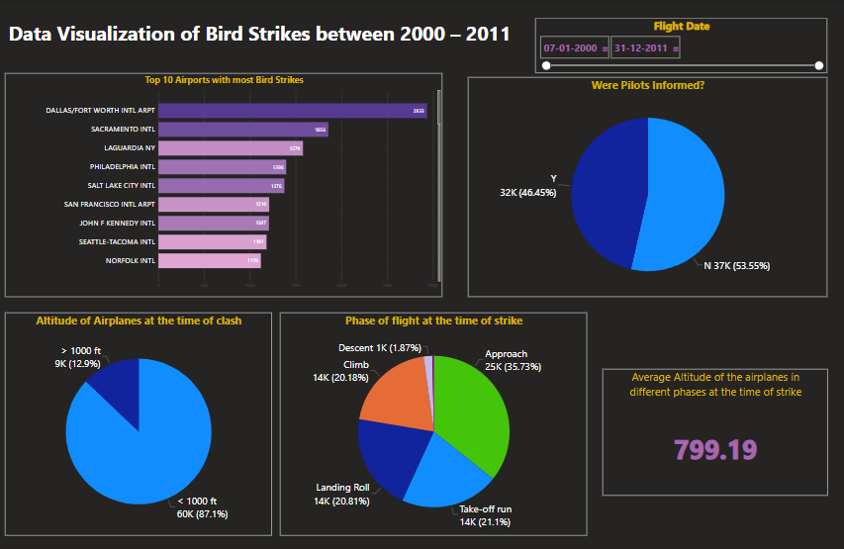
Page 2

Slide 8
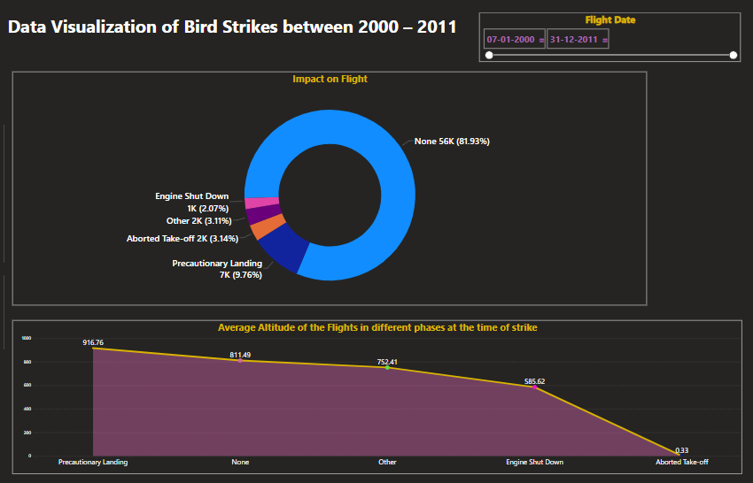
Page 3

Slide 9
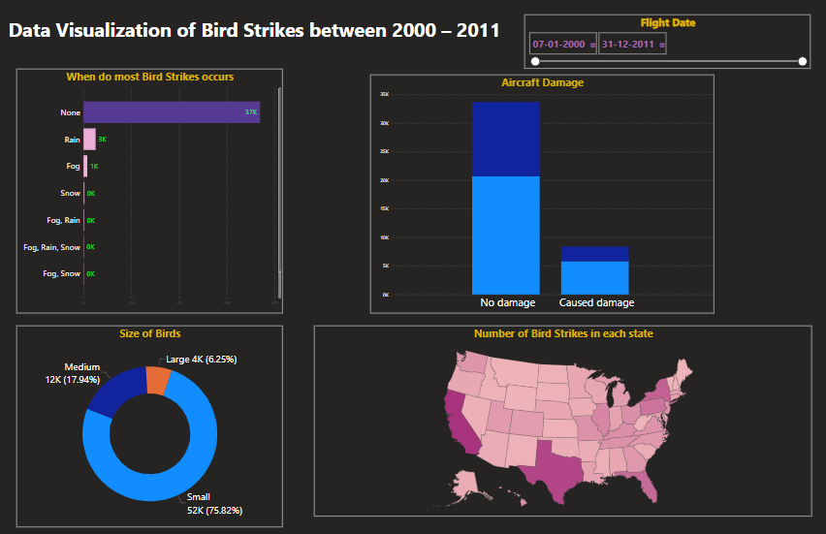
Page 4

Slide 10
Thank you

